Slide 1
Classical Data Analysis & Statistical Test
Prof Maheswari S
VIT Chennai

Slide 2
Analyzing Software Measurement Data-Statistical Distributors and Hypothesis Testing-Classical Data Analysis Techniques

Slide 3
Analysing Software Measurement Data
Data set created from entities, resources,….
One or more attributes can be framed as a data set
Nature of data set – needs to be compared

Slide 4
Statistical Techniques
Learning attribute values
Distribution of attribute values
Analyzing the results of experiment by the few methods of measures of central tendency, measures of dispersion, F- statistics, level of significance, confidence limits

Slide 5
Nature of the data
Sampling
Population
Data distribution

Slide 6
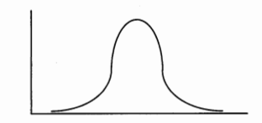
Normal Distribution

Slide 7
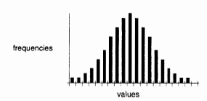
Data resembling a normal distribution

Slide 8
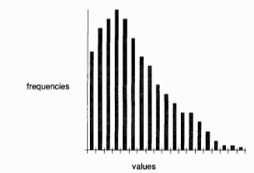
Distribution where data are skewed to the left

Slide 9
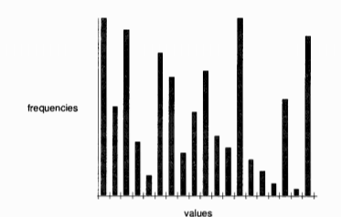
Non normal distribution

Slide 10
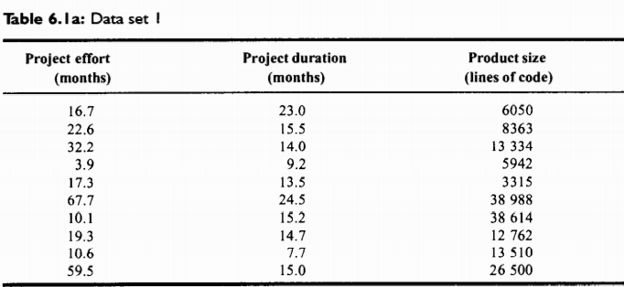

Slide 11
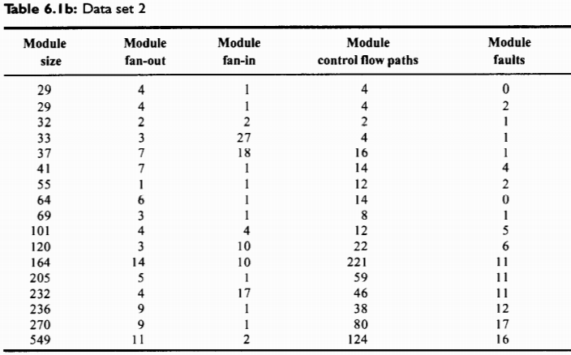

Slide 12
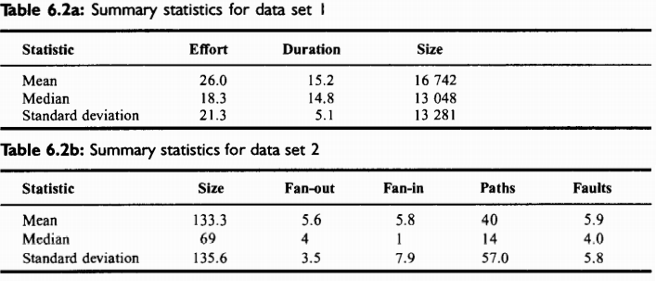

Slide 13
Statistical inference and hypothesis testing
Making or drawing a conclusion from observations
Parametric Test– Normal distribution
Put simply, a hypothesis is a specific, testable prediction. More specifically, it describes in concrete terms what you expect will happen in a certain circumstance. A hypothesis is used to determine the relationship between two variables, which are the two things that are being tested.

Slide 14
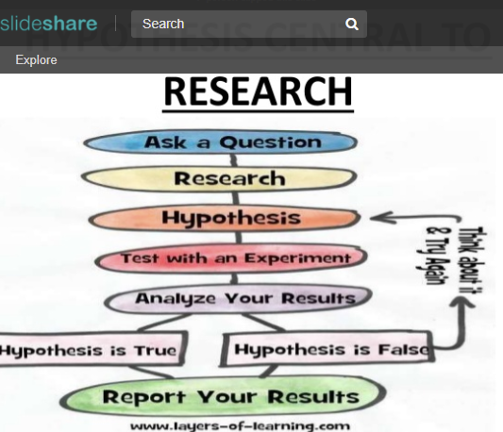

Slide 15
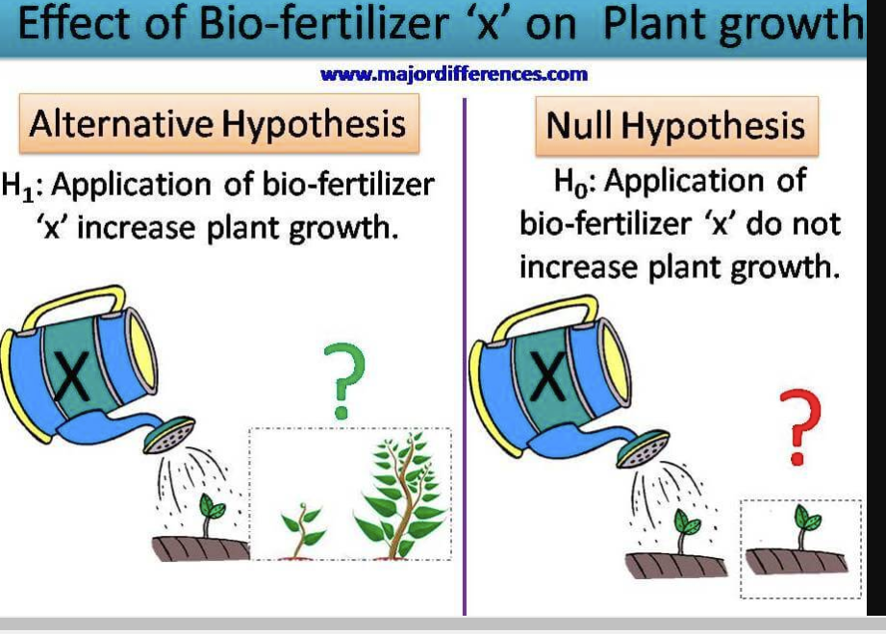

Slide 16
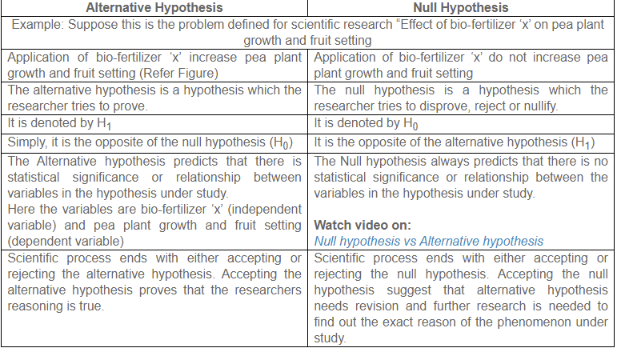

Slide 17
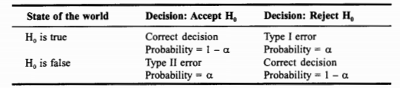
Type I, Type II error
Results of hypothesis testing

Slide 18
Purpose of a experiment
To confirm theory
To explore a relationship

Slide 19
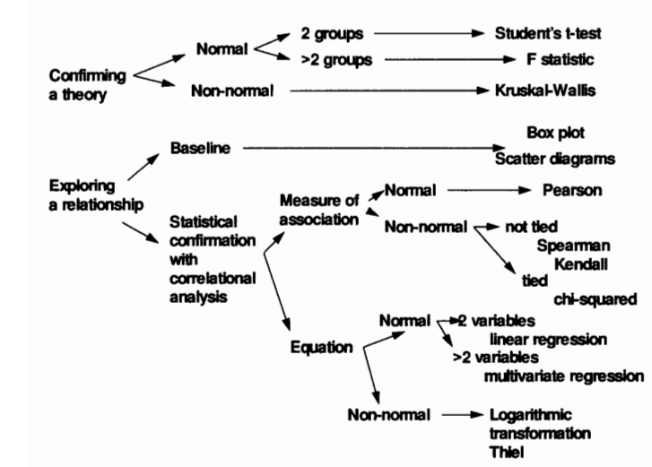

Slide 20
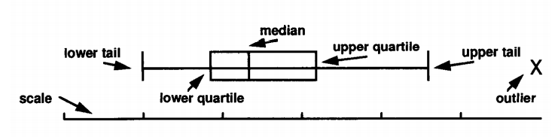
Box plot

Slide 21
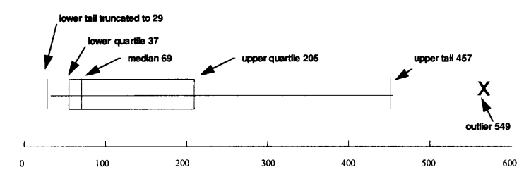
Box Plot of data set 2

Slide 22
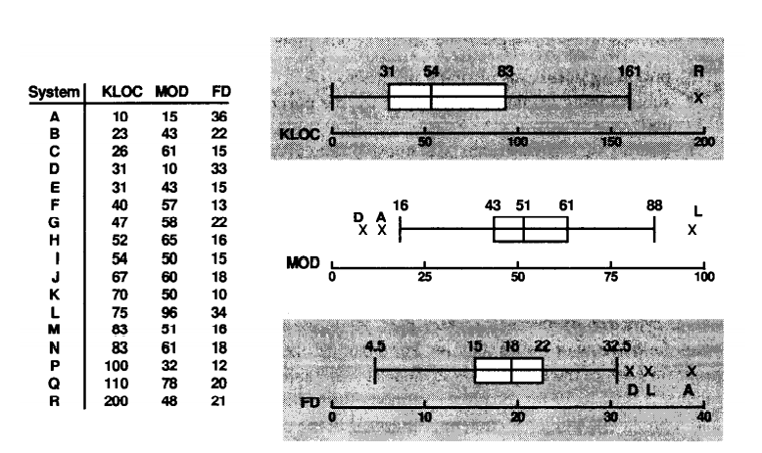

Slide 23
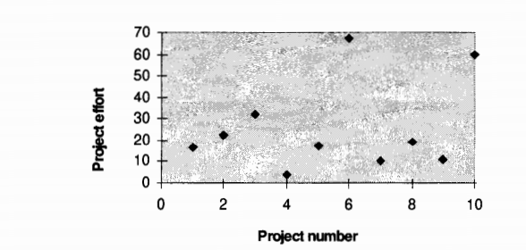
Scatter Plot for data set 1

Slide 24
Control Chart
Helps to check the data present in the acceptable bounds or not
.

Slide 25
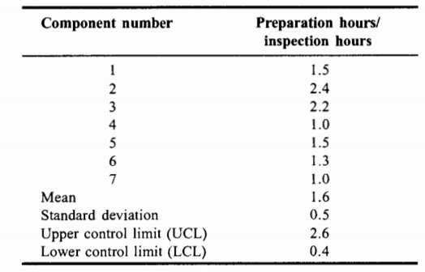

Slide 26
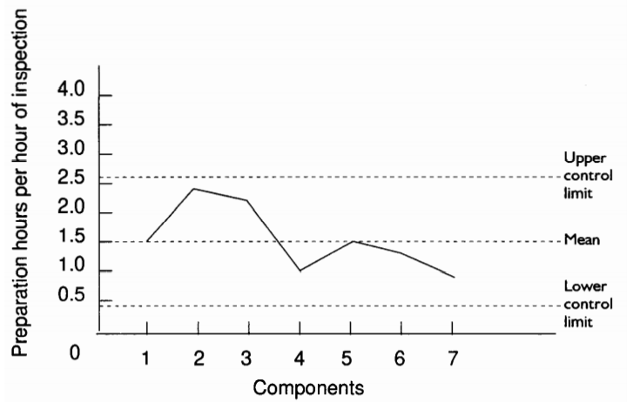

Slide 27
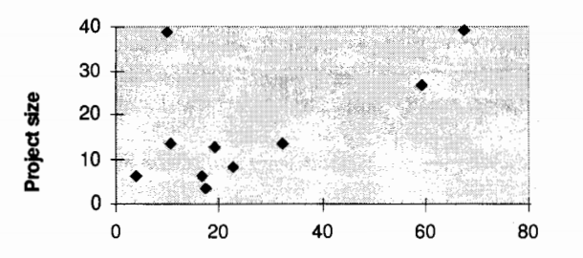

Measures of association Method I
Pearson correlation coefficient

Slide 28
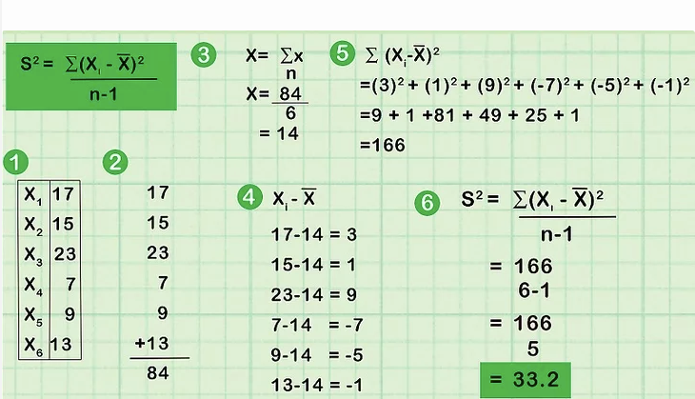

Slide 29
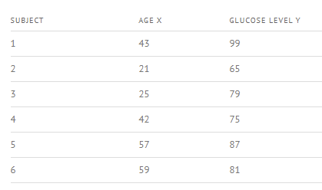
Method II

Slide 30
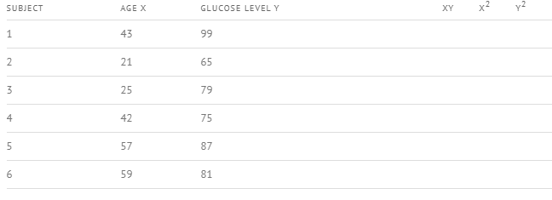
Step 1

Slide 31
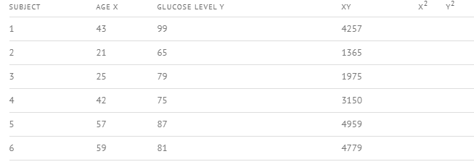
Step 2

Slide 32
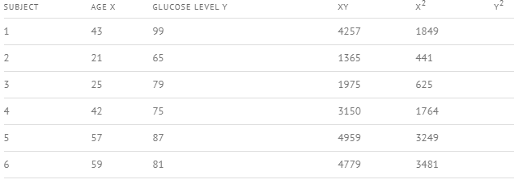
Step 3

Slide 33
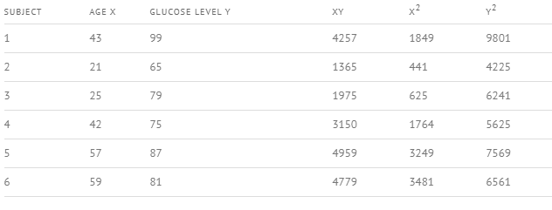
Step 4

Slide 34
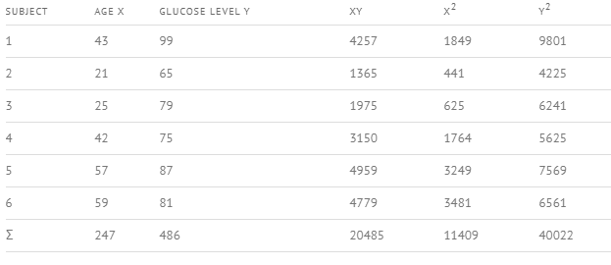
Step 4

Slide 35

Step 5 - Use the formula

Slide 36
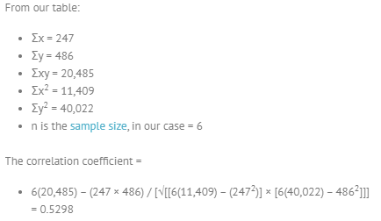
Step 6
The range of the correlation coefficient is from -1 to 1. Our result is 0.5298 or 52.98%, which means the variables have a moderate positive correlation.

Slide 37
Robust Correlation
Spearman’s rank correlation coefficient

Slide 38
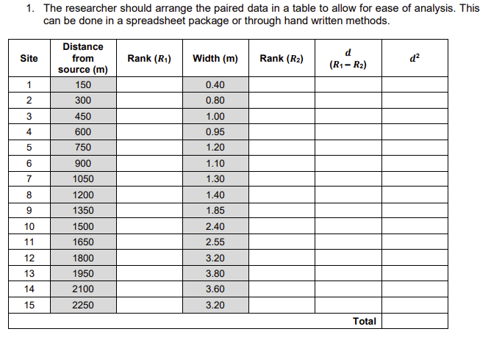

Slide 39
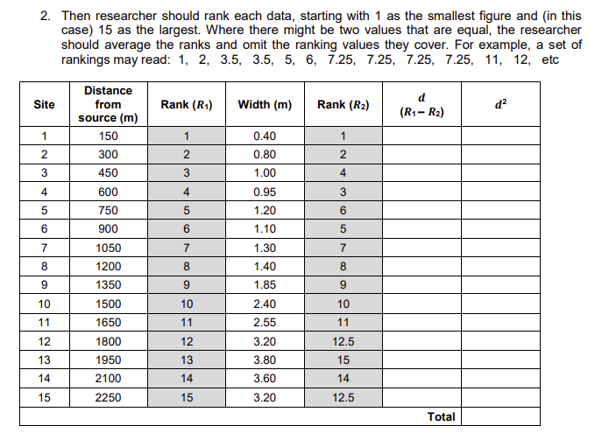

Slide 40
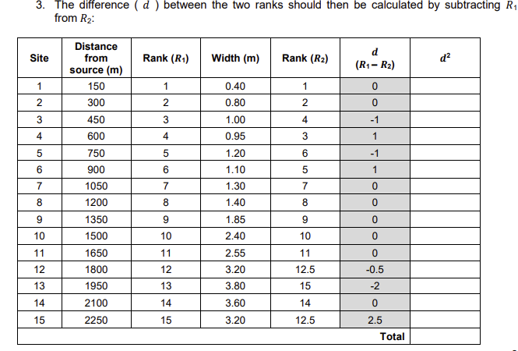

Slide 41
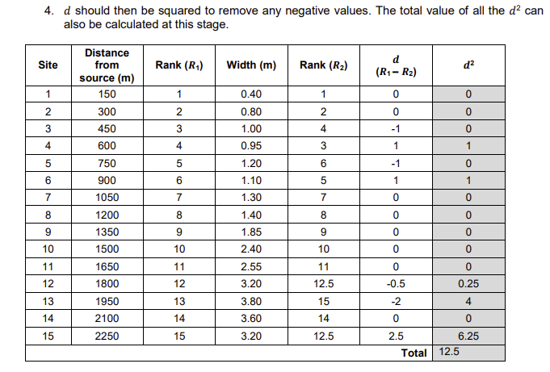

Slide 42
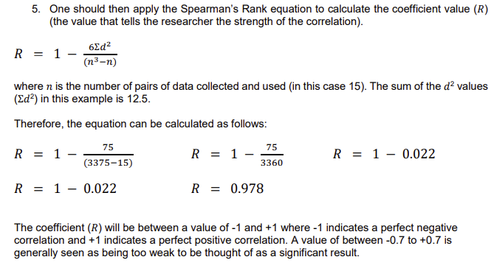

Slide 43
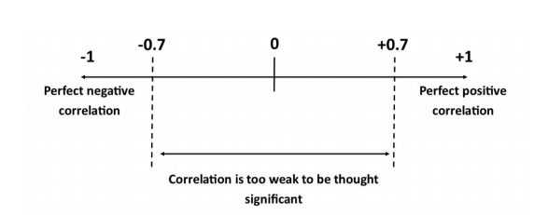
- Shows strong positive correlation

Slide 44


Slide 45
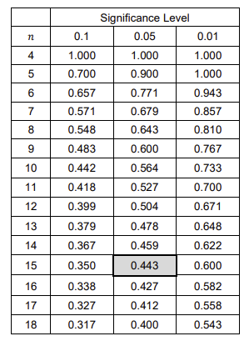
Significance Table

Slide 46

Analysis

Slide 47
Question
The given table provides data about the percentage of students who have free university meals and their CGPA scores. Calculate the spearman rank correlation between the two and interpret the result.

Slide 48
Data
State of University | % of students having free meals | % of students scoring above 8.5 CGPA
Pune | 14.4 | 54
Chennai | 7.2 | 64
Delhi | 27.5 | 44
Kanpur | 33.8 | 32
Ahmedabad | 38 | 37
Indore | 15.9 | 68
Guwahati | 4.9 | 62

Slide 49

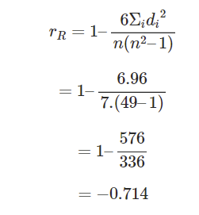
Solution

